Slide 1


SECURE SOFTWARE DEVELOPMENT (SSD)
Diploma in CSF
Academic Year (AY) 20/21 – Semester 3 (April `20)
Week 4
Secure software requirements – Part 2
Last Updated: 10/05/2020

Slide 2
Contents
Remote Learning Instructions
Mission 4.1 sBooks Pte Ltd Case Study
Mission 4.2 Razor Pages Security I

Slide 3
Remote Learning Instructions
Step 1
Read Week 4 Reading Materials
Details in Slide 5
Step 2
Attempt the open-ended question
More details in slide 12
Step 3
Do Mission 4.1
Download the attached case study - “sBooksPteLtd-CaseStudy.pdf”
More details in slide 13
Step 4
Do Mission 4.2
More details in slide 14

Slide 4
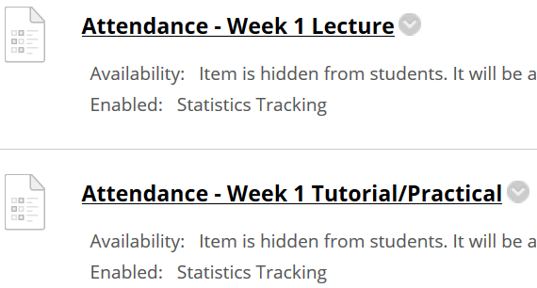
Important Details
VERY IMPORTANT
Visit MEL to start each week’s lesson. Learning materials will ONLY be released in MEL
Attendance Poll Attempt TWO attendance polls every week Starts Monday (9am) till Friday (11:59pm) Attendance :– Week x Lecture ( x refers to week number) Week x Tutorial/Practical Just click “Save and Submit”
Always lookout for announcements Do keep abreast of announcements in MEL
In light of the Covid-19 situation, your cooperation in adhering to the points mentioned is much needed and greatly appreciated.

Slide 5
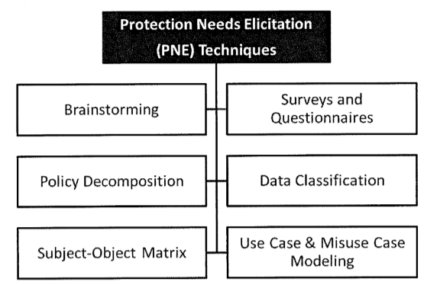
How to gather software security requirements?
Read Gathering Software Security Requirement

Slide 6
Brainstorming
Quickest but unstructured method to security requirement gathering
Primarily used to determine preliminary security requirement
Shortcoming exists in that security requirement may not relate to business context
Therefore, at times, brainstorming can be subjective

Slide 7
Surveys and Questionnaires
An effective mean to collect functional and assurance requirements
As per any surveys, quality of questions asked determines effectiveness of survey.
Example of security questions that can be included:-
Is data highly sensitive or confidential in nature?
What is the maximum tolerable downtime?
Is there a need for single sign-on?

Slide 8
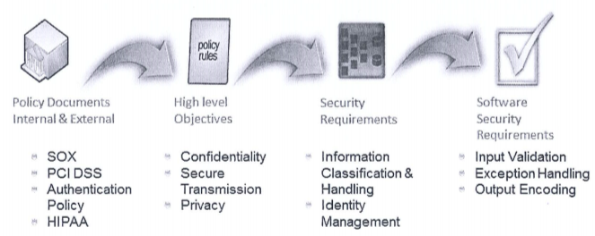
Policy Decomposition
Generally, sources of security requirement can be from internal organizational policy and/or external regulatory authority.
Policies contain high level mandate that needs to be decomposed to filter off the security requirement.

Slide 9
Data Classification
Data classification is the conscious effort to assign labels (a level of sensitivity) to information (data) assets.
It is based on potential impact to confidentiality, integrity and availability (CIA) upon disclosure, alteration or destruction.
One of the main objectives of data classification is to lower cost of data protection and maximises the return on investment when data is protected.

Slide 10
Subject-Object Matrix
Subject-Object matrix is used to identify allowable actions between subjects (roles) and objects (components) based on use cases.
A subject-object matrix is a two-dimensional representation of roles and components.
By inversing the allowable actions captured in subject-object matrix, one can determine existence of threats.

Slide 11
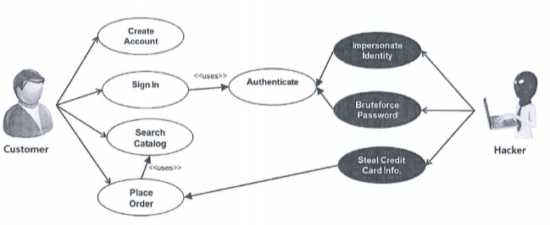
Use Case & Misuse Case Modelling
Use case modelling is a mechanism by which software functionality and security requirements can be determined.
From use cases, misuse cases can be developed.
Misuse cases/Abuse cases can help identify security requirement by modelling negative scenarios.

Slide 12
Open-Ended Question
Qn 1: It was mentioned that life won’t be back as we were used to, for a sizeable period of time, once circuit breaker period is over due to the Covid-19 situation.
In your own words, explain how would that impact security requirement gatherings?
Cite an example of one PNE (refer to slide 5) that will be affected.
Attempt the open-ended question above.
Submit your answers in Teams group.
SSD-AY2021-xxx-Pxx → Week 4
Use “Conversations” tab under “SSD-AY1920-xxx-Pxx → Week 4” to discuss within your class group.

Slide 13
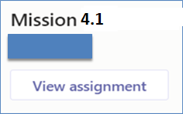
Mission 4.1: sBooks Pte Ltd Case Study
Read the attached case study – sBooks Pte Ltd.
sBooksPteLtd-CaseStudy.pdf
Answer the questions in the case study.
Sample answer (Guide) → sBooksPteLtd-CaseStudy-ExpectedAnswerGuide2.pdf
Submit Mission 4.1 in MEL.
Deadline: End of Week 4 Penalty for late submission
If you got any issues regarding Mission 4.1
Use “Conversations” tab under “SSD-AY1920-xxx-Pxx → Week 4” to discuss within your class group.
Tutors would also monitor these “Conversations”

Slide 14
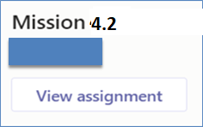
Mission 4.2: Razor Pages Security I
Attempt the Razor Pages Security I practical
Download Razor Pages Security I practical guide from MEL.
Submit detailed screenshots of your completed practical page in MEL.
The screenshots must show the browser’s “Address Bar” to verify the application is running in your laptop.
Deadline: End of Week 4
Penalty for late submission
If you got any issues regarding Mission 4.2
Use “Conversations” tab under “SSD-AY1920-xxx-Pxx → Week 4” to discuss within your class group.
Tutors would also monitor these “Conversations”.

